Slide 1

Patient Treatment System
Java swing | Factory Pattern | DB4O Database
Zigeng Fu, Yitong Liu, Xiao Liu

Slide 2


Problem Statement
Diverse regions, enterprises, organizations, roles
Complex work flows and inefficient cooperation
Imperfect data integrity and systematisms
Solution - Patient Treatment System
Efficient communications between stakeholders
Traceable different kinds of work flow
Object oriented data storage using DB4o
Scalable system structure using factory pattern

Slide 3
Techniques
Java Inheritance
.
Work Queue-Work Request Mechanism

.
80%
Factory Pattern
DB4o
.
.


Slide 4
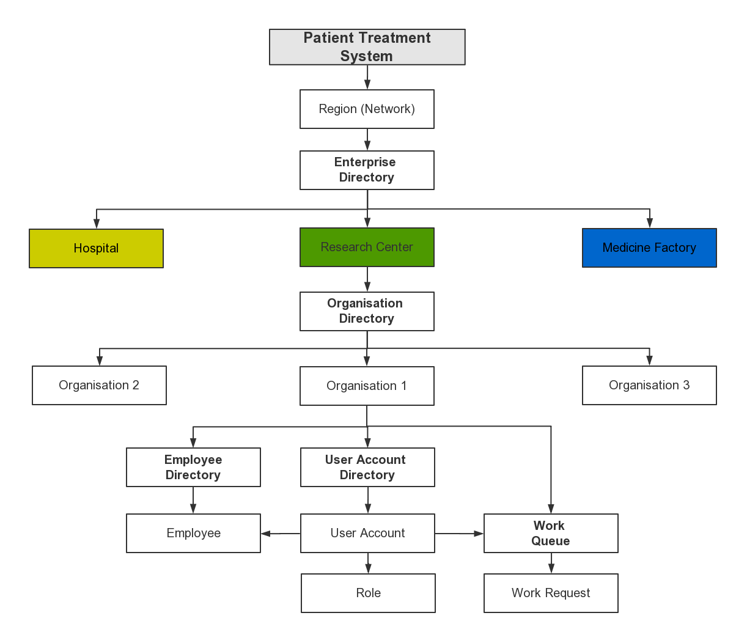
Object Models
System
Regions
Enterprises
Organizations
Object Hierarchy

Slide 5
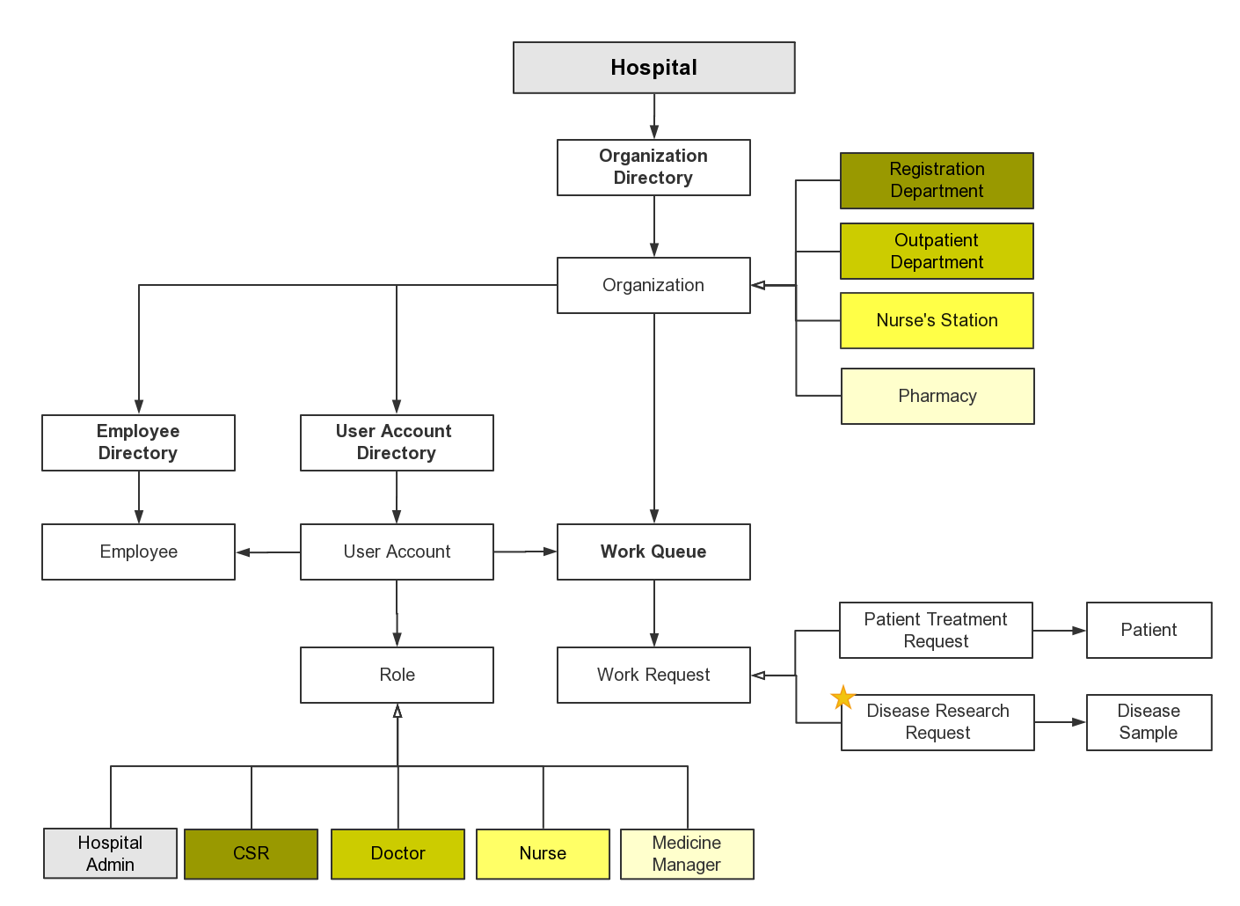
Object Models (cont.)

Slide 6
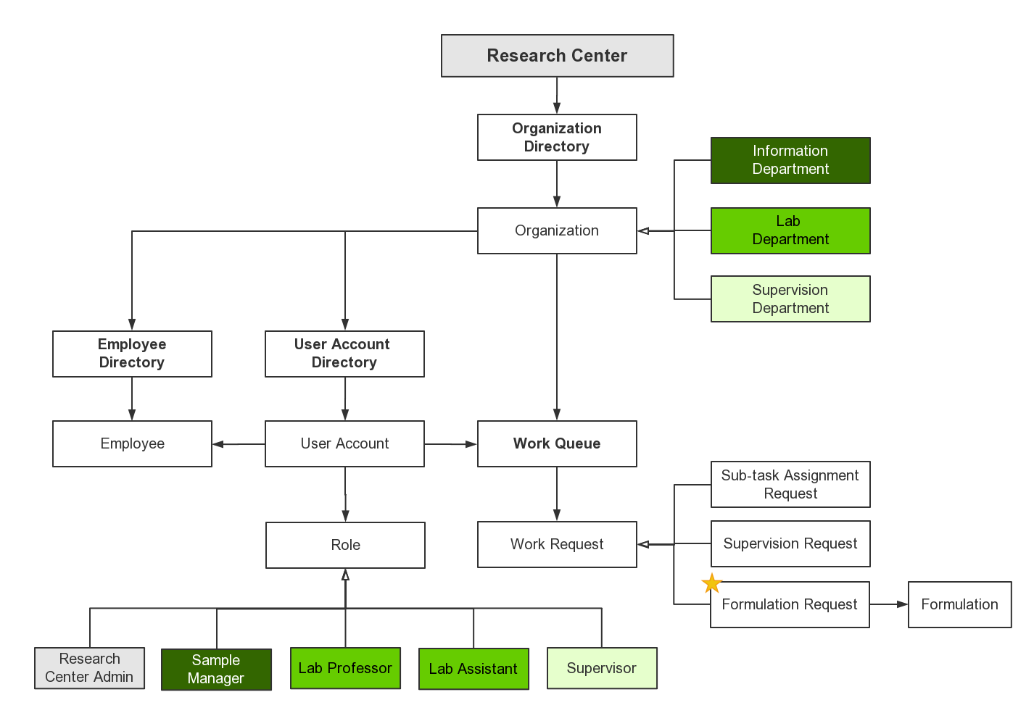
Object Models (cont.)

Slide 7
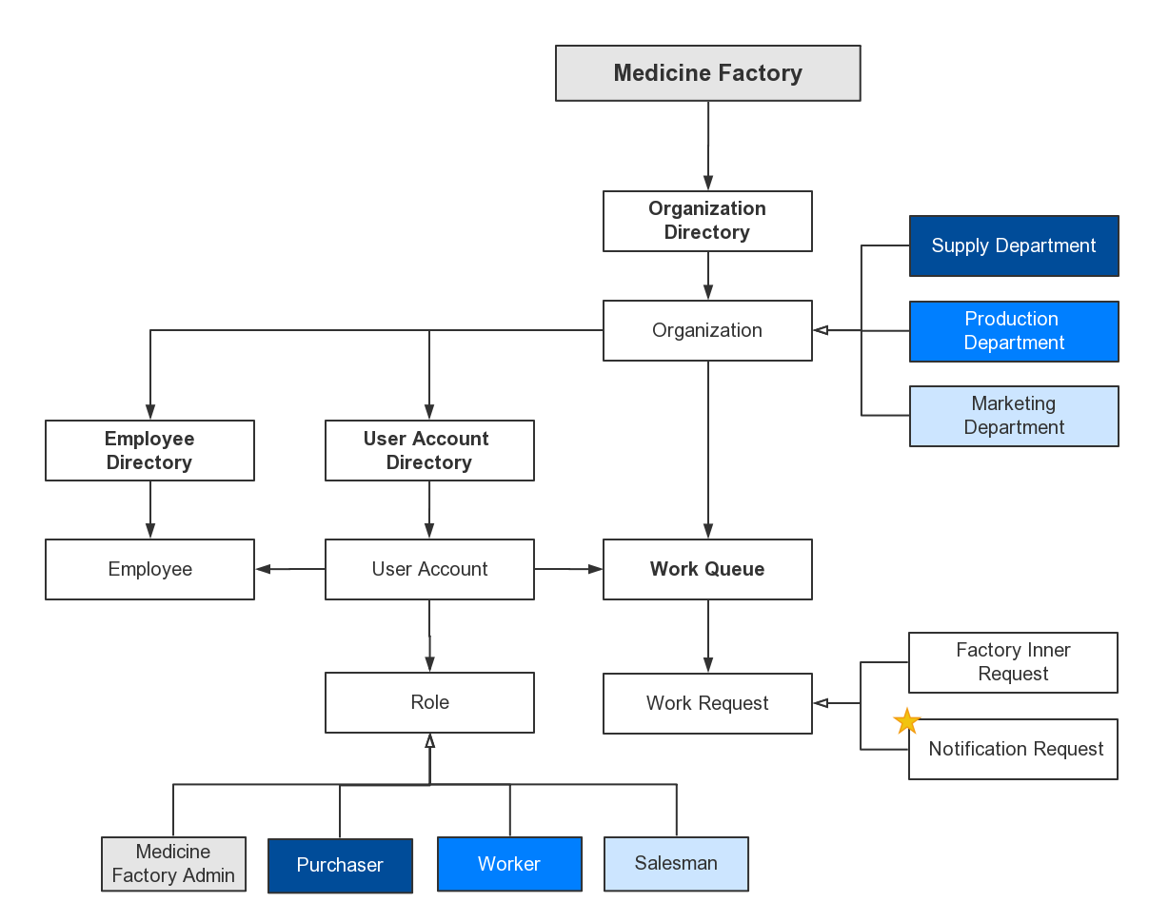
Object Models (cont.)

Slide 8

Work Flow (Hospital)
Patient Registration Center
01
Registration Staff: create patient and assign to a doctor
Patient Treatment Req
02
Outpatient Department
Doctor: treat patient and decide medicine or hospitalization
Patient Treatment Req
03
Patient Treatment Req
04
Nurse Station
Disease Research Req
Nurse: assign beds for patients, and record health situation
Pharmacy
Medicine Manager: prepare medicine and purchase medicine from factories

Slide 9

Disease Research Req
Work Flow (Research Center)
05
Information Center
Sample Manager: receive research request, assign task to labs
Disease Research Req
Disease Research Lab
06
Professor: receive task, assign sub-tasks to lab assistants, gather results
Lab Assistant: complete sub-task, feedback formulation
Sub-task Req
Supervision Req
07
Supervision Department
Supervisor: reject the formulation or put forward the formulation and disease to factory
Formulation Req

Slide 10
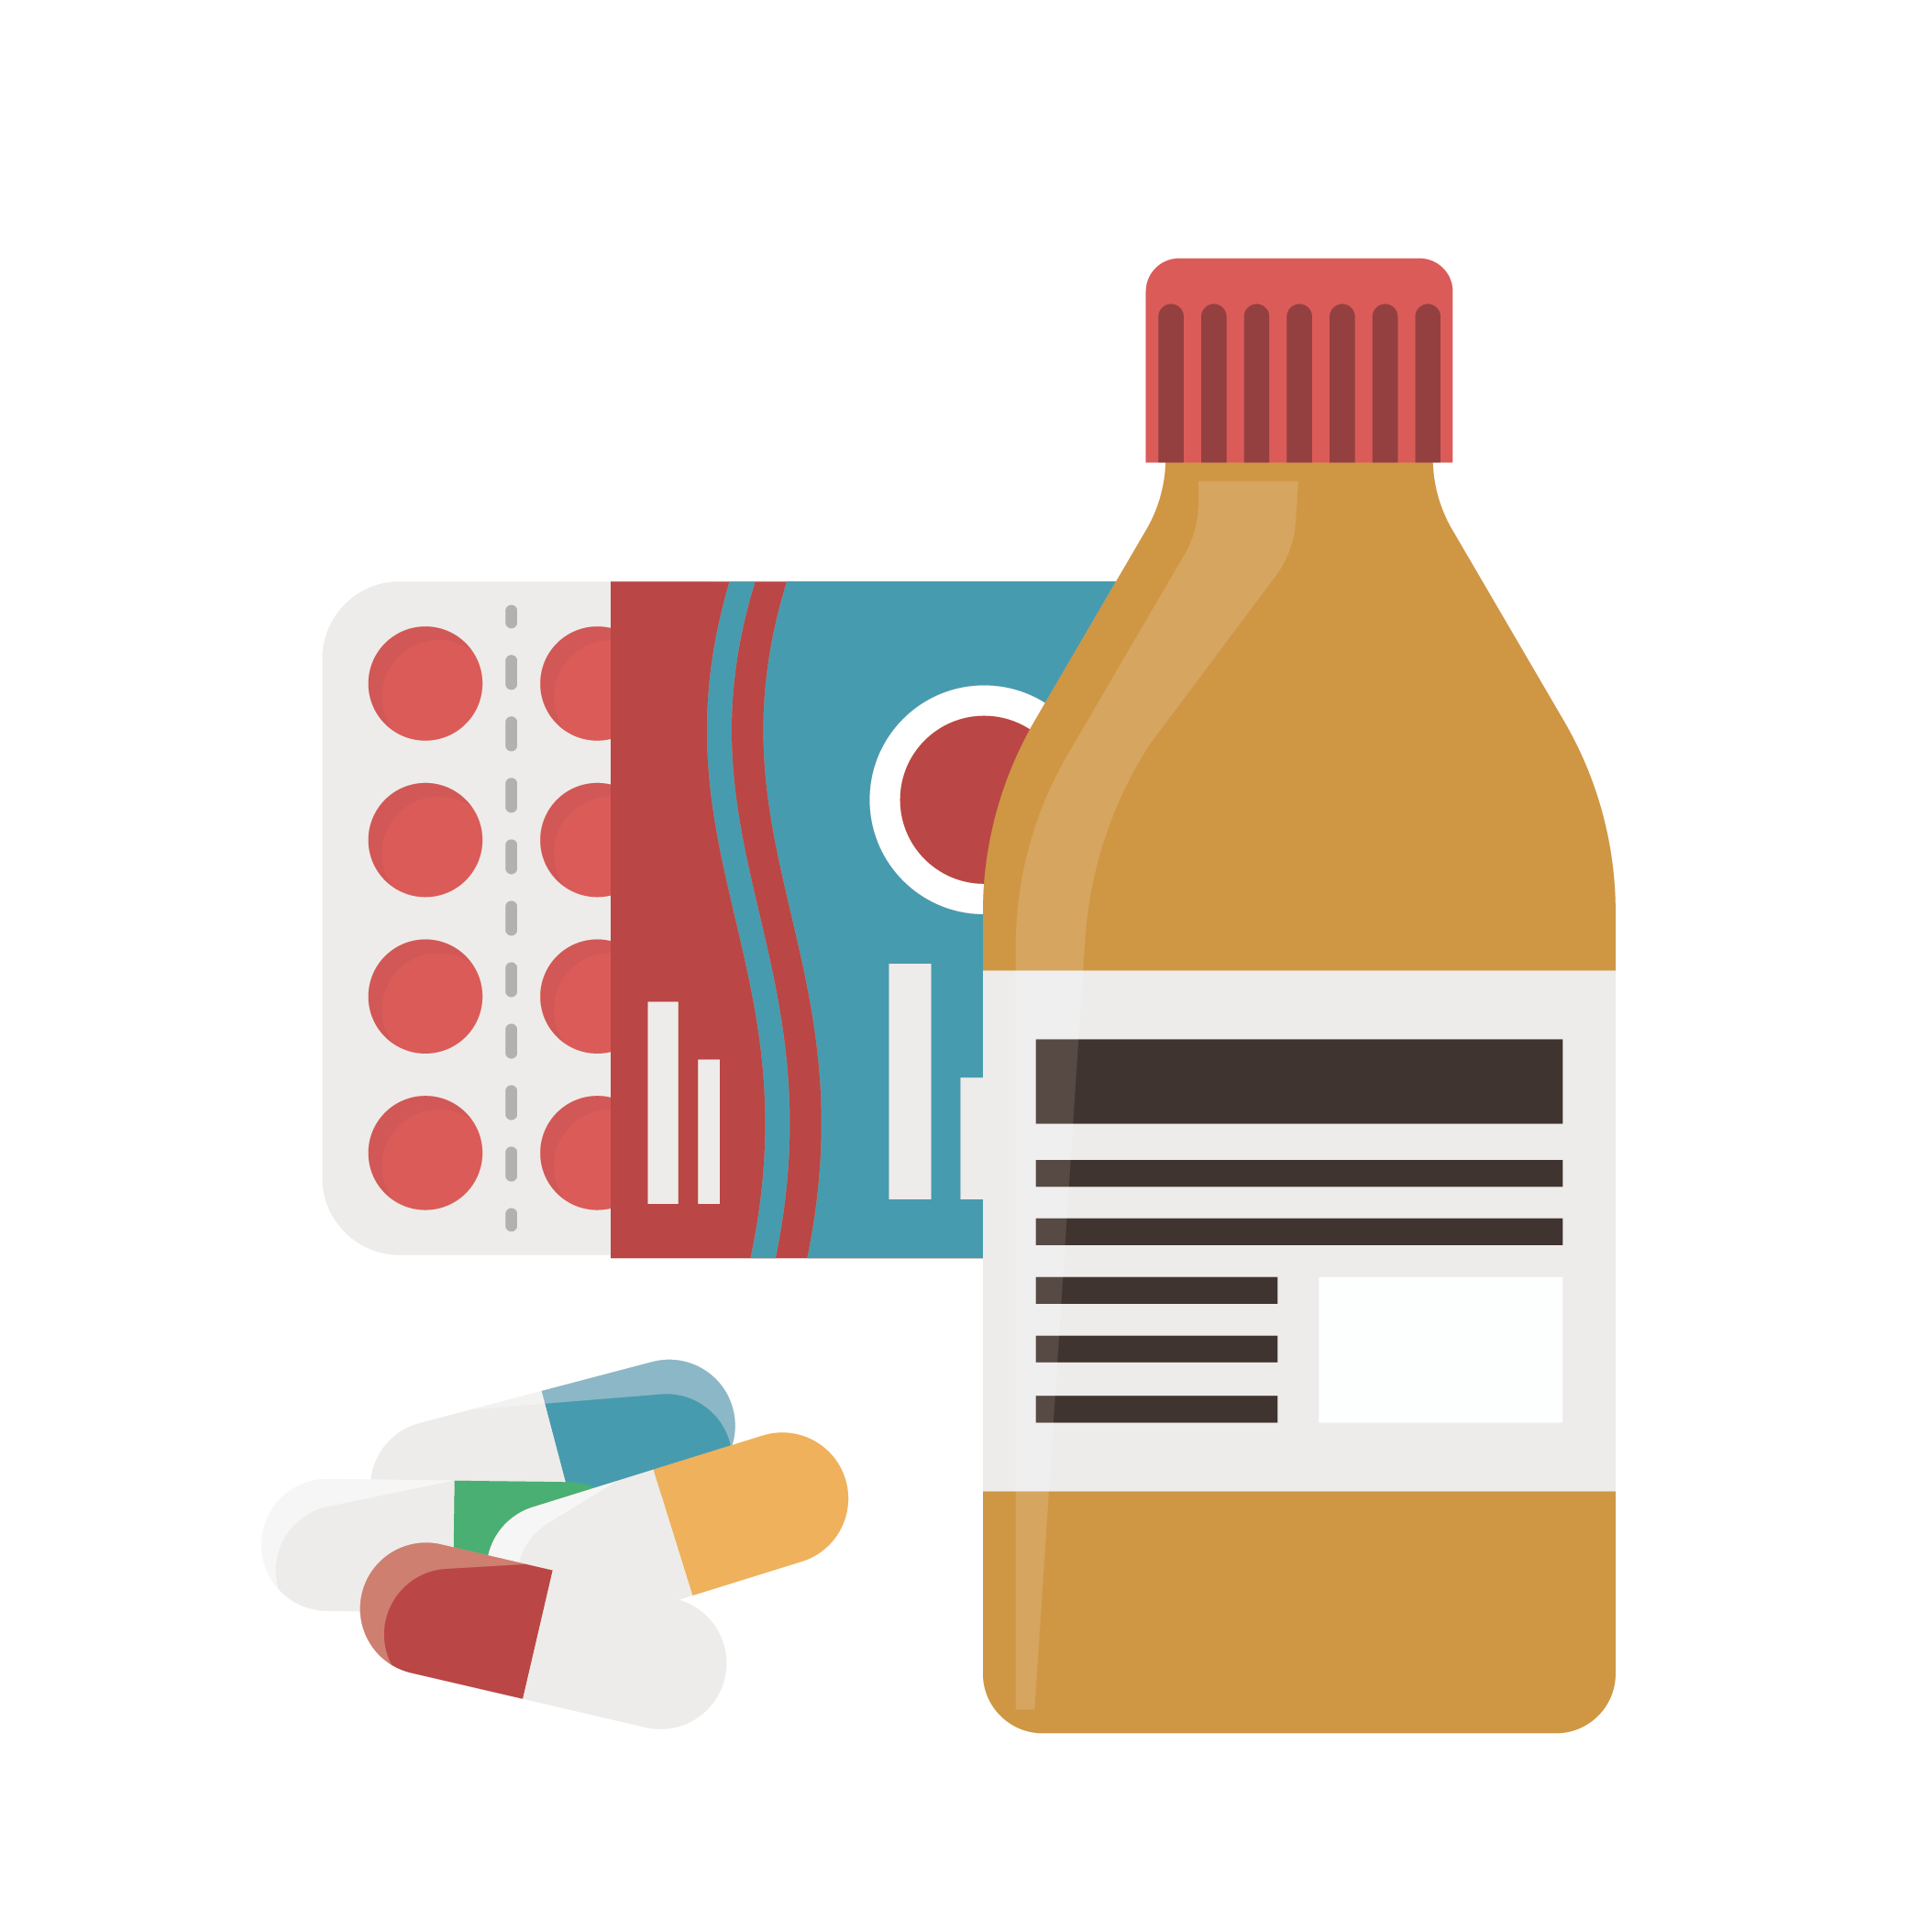
Formulation Req
Work Flow (Medicine Factory)
Supply Department
08
Purchaser: manage in-stock ingredient quantity
Factory Inner Req
Production Department
09
Manager: assign production work to worker
Worker: produce medicine
Factory Inner Req
Factory Inner Req
10
Marketing Department
Marketing Manager: send notification to factory
Notification Req

Slide 11

Demo Presentation
Thanks for professor, TAs and contributions from lovely team members

